Slide 1
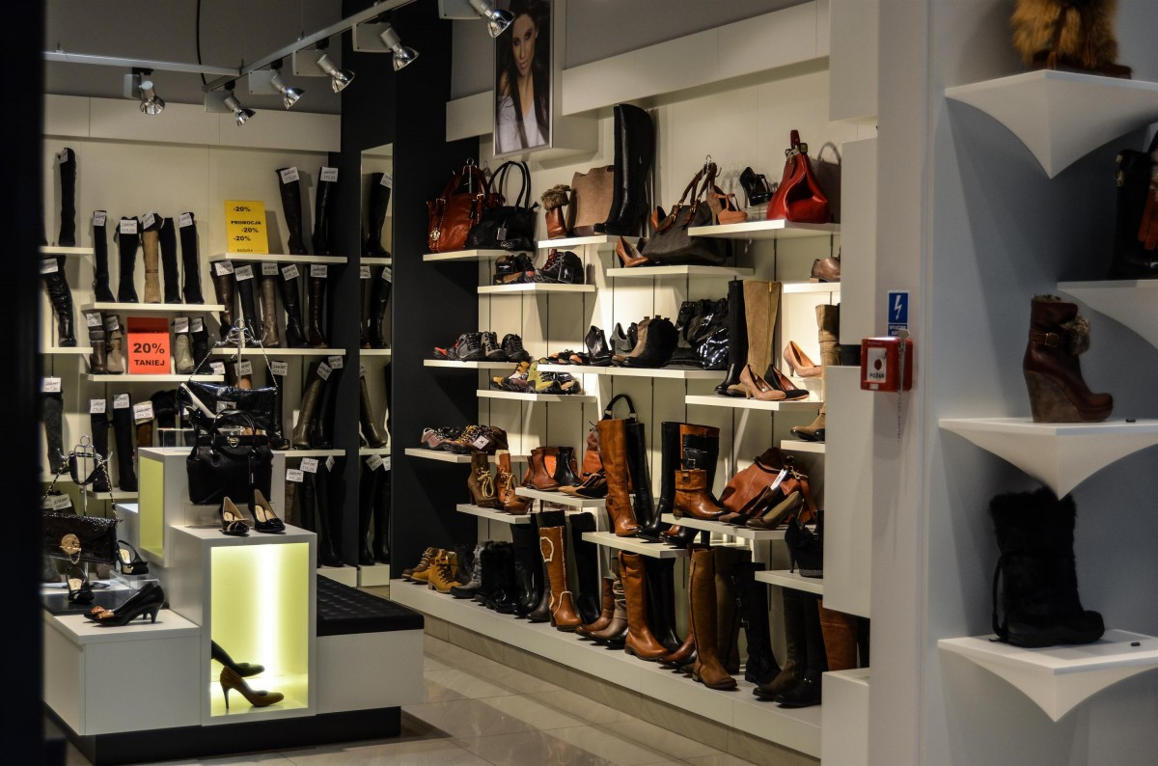
Trend Style
SHOPPING
TREND ANALYSIS PROJECT
FROM DATA TO DECISIONS
PRESENTED BY:
Ivy Wangechi Kariuki

Slide 2

PROBLEM STATEMENT
TrendStyle, a retail clothing store chain owned by Mr. Alex, has been experiencing a decline in sales and an increase in customer churn across multiple locations. Despite implementing various promotions and marketing campaigns, these efforts have not successfully reversed the negative trend. Mr. Alex needs data-driven insights to identify the key factors contributing to customer churn, understand customer purchasing behavior, and develop effective strategies to improve retention and boost sales.
This project aims to analyze customer shopping data to:
Identify the top 5 factors contributing to customer churn.
Segment customers based on purchasing behavior and demographics.
Evaluate the impact of discount strategies on customer lifetime value (CLV) and retention.
Predict customers at high risk of churning using machine learning models.
Provide actionable recommendations to improve customer loyalty and sales performance.
By utilising data analytics and predictive modeling, this project will help Mr. Alex make informed decisions to enhance customer retention and boost sales thus ensuring long-term business growth.

Slide 3
DATASET OVERVIEW
About The Dataset
Sample Size: 3900 Individuals
Data Shape:
The Dataset contains 19 columns and 3900 rows.
Data Type:
Categorical Columns(14): Gender, Item Purchased, Category, Location, Size, Color, Season, Subscription Status, Payment Method, Shipping Type, Discount Applied, Promo Code Used, Preferred Payment Method, Frequency of Purchases.
Numerical Columns(5): Customer ID, Age, Purchase Amount (USD), Previous Purchases, Review Rating

Slide 4
EXPLORATORY DATA ANALYSIS
Data Cleaning and Preprocessing.
Cleaning and Preparing the Data
Steps Taken:
Checked for missing Values: There were no missing values.
Duplicates: The dataset has are no duplicates.
Encoded the following categorical variables using Mapping (Gender, Item Purchased, Category, Location, Size, Color, Season, Subscription Status, Payment Method, Shipping Type, Discount Applied, Promo Code Used, Preferred Payment Method, Frequency of Purchases.).
In this case, removing outliers may distort the data analysis, as the dataset is relatively small, with a sample size of 3,900. Outliers can sometimes represent important variations in customer behavior rather than errors. Removing outliers could result in losing important information and create bias, making the model less accurate and reliable.
New columns such as 'Region' and 'Segment' have been added to enhance data analysis, making it easier to categorize and interpret customer insights.

Slide 5
Descriptive Statistics Of The Dataset
Feature | Age | Purchase Amount (USD) | Review Rating | Previous Purchases
count | 3900.000000 | 3900.000000 | 3900.000000 | 3900.000000
mean | 44.068462 | 59.764359 | 3.749949 | 25.351538
std | 15.207589 | 23.685392 | 0.716223 | 14.447125
min | 18.000000 | 20.000000 | 2.500000 | 1.000000
25% | 31.000000 | 39.000000 | 3.100000 | 13.000000
50% | 44.000000 | 60.000000 | 3.700000 | 25.000000
75% | 57.000000 | 81.000000 | 4.400000 | 38.000000
max | 70.000000 | 100.000000 | 5.000000 | 50.000000
Summary
Age - Minimum age is 18 while maximum age is 70 and most of the individuals are aged between 31 and 57 years.
Purchase Amount (USD) - Minimum amount is 20 while maximum age is 100 and most of the individuals are spend between 39 and 81 dollars.
Review Rating - Minimum rating is 2.5 while the maximum is 5. The average review rating is 3.7.
Previous Purchases - Varies between 1 and 50. Customers have made an average of 25 past purchases.

Slide 6
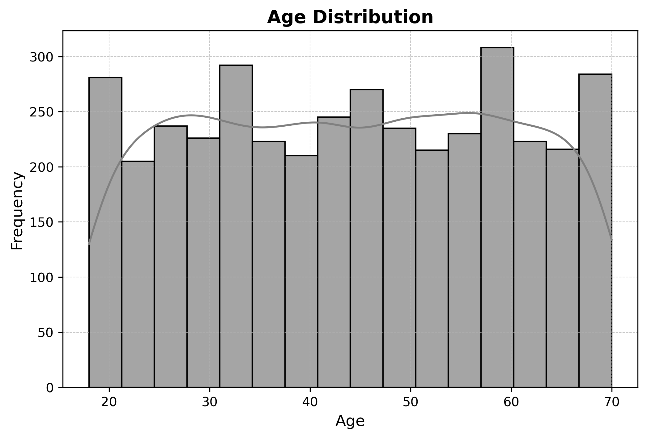
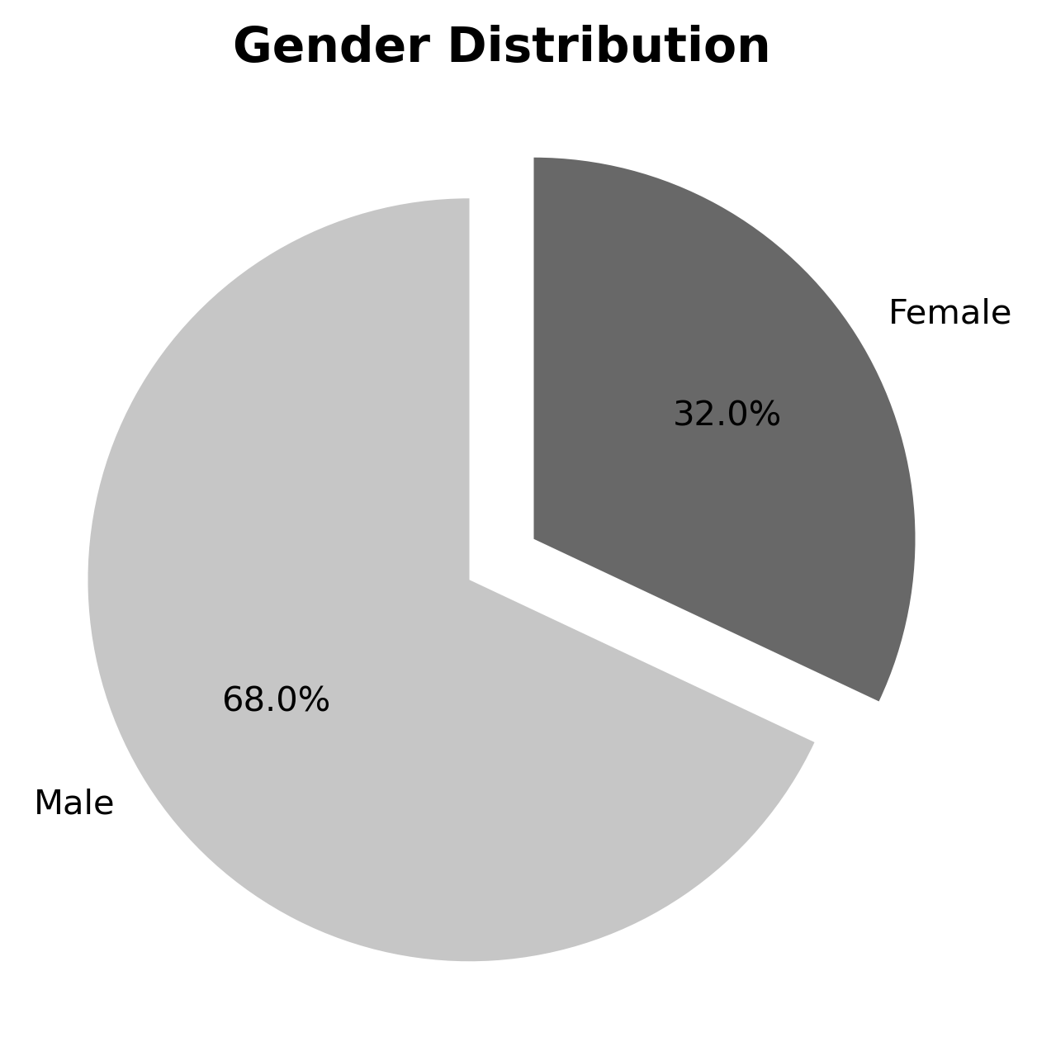
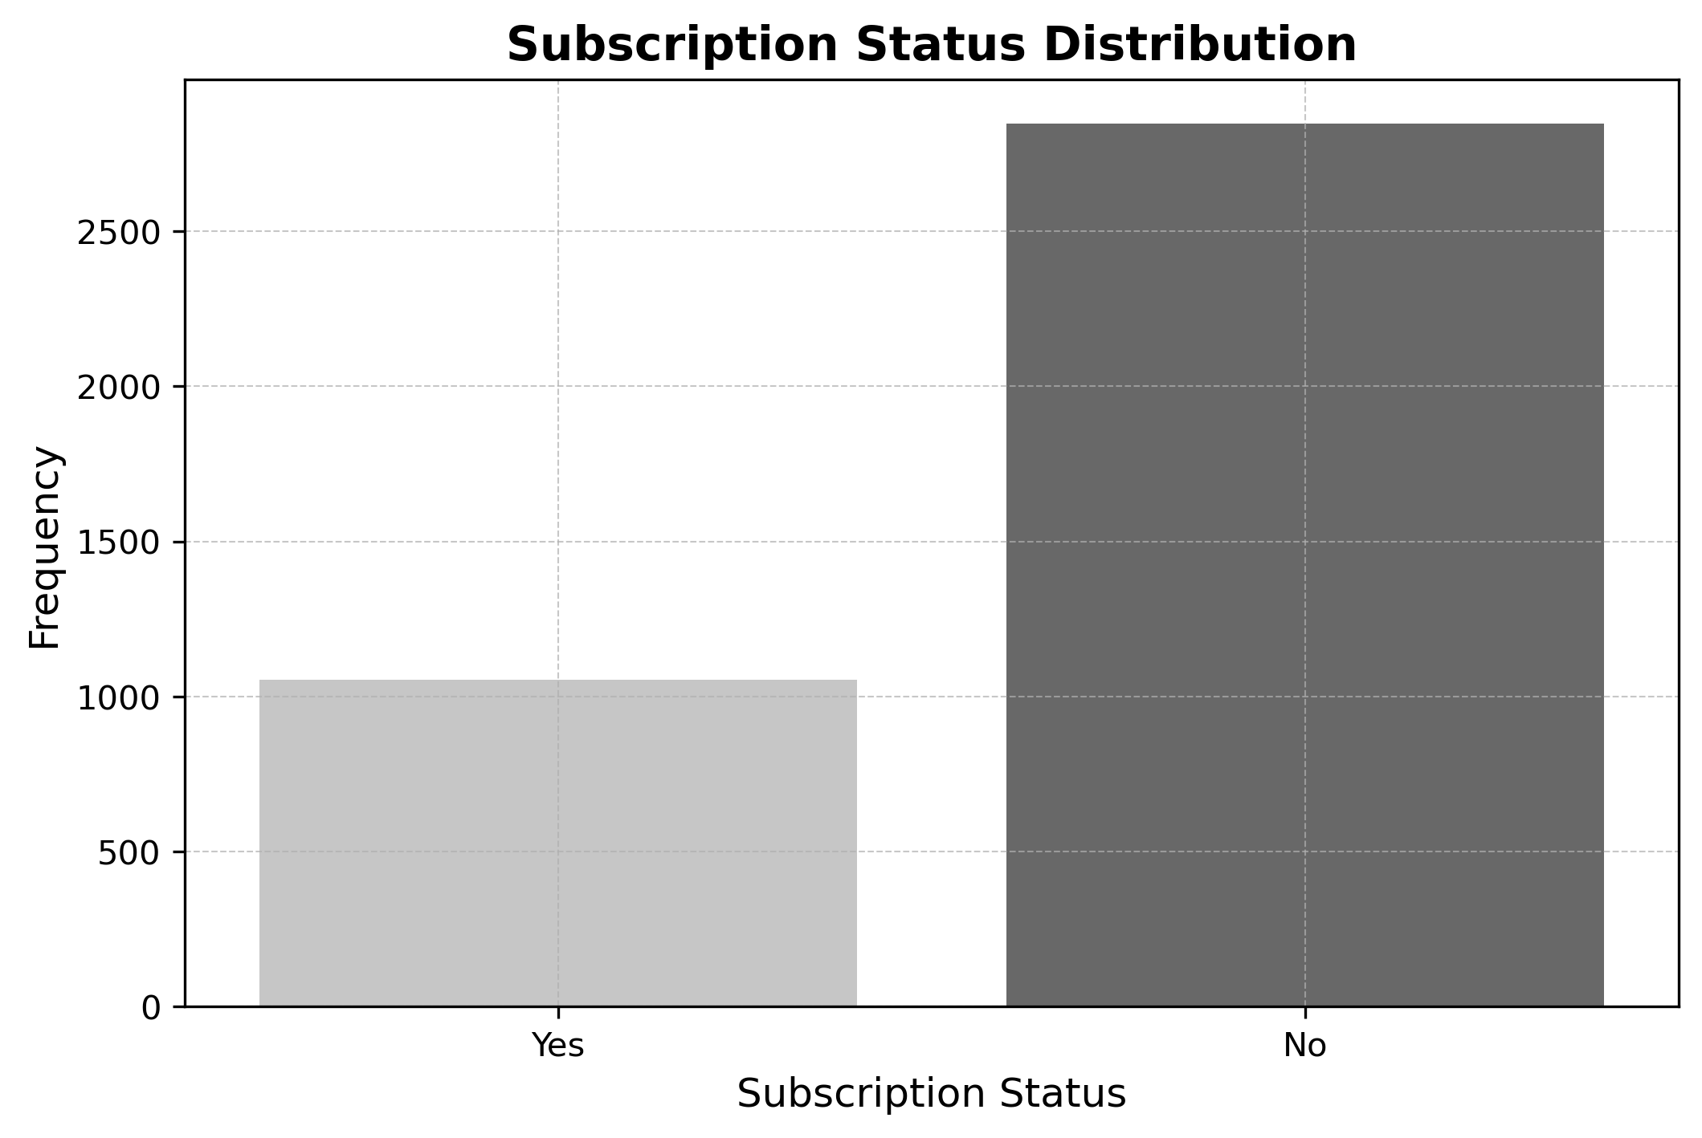
VISUALIZATIONS
a. Univariate Visualizations
Age has a uniform distribution which means that the store has a balanced customer base. The store can tailor its products and marketing to suit different shoppers by offering a mix of trendy and classic clothing styles ensures that all age groups find something they like.
The majority of the customers are male(68%), with the remaining portion being female(32%)
Over 2500 customers do not have an active subscription status, while about 1000 customers have an active subscription status. This suggests that a large portion of customers are not actively engaged with the store's subscription program. To improve retention, the store could offer exclusive benefits such as early access to new arrivals, free shipping, personalized shopping recommendations, or loyalty rewards for subscribers.

Slide 7
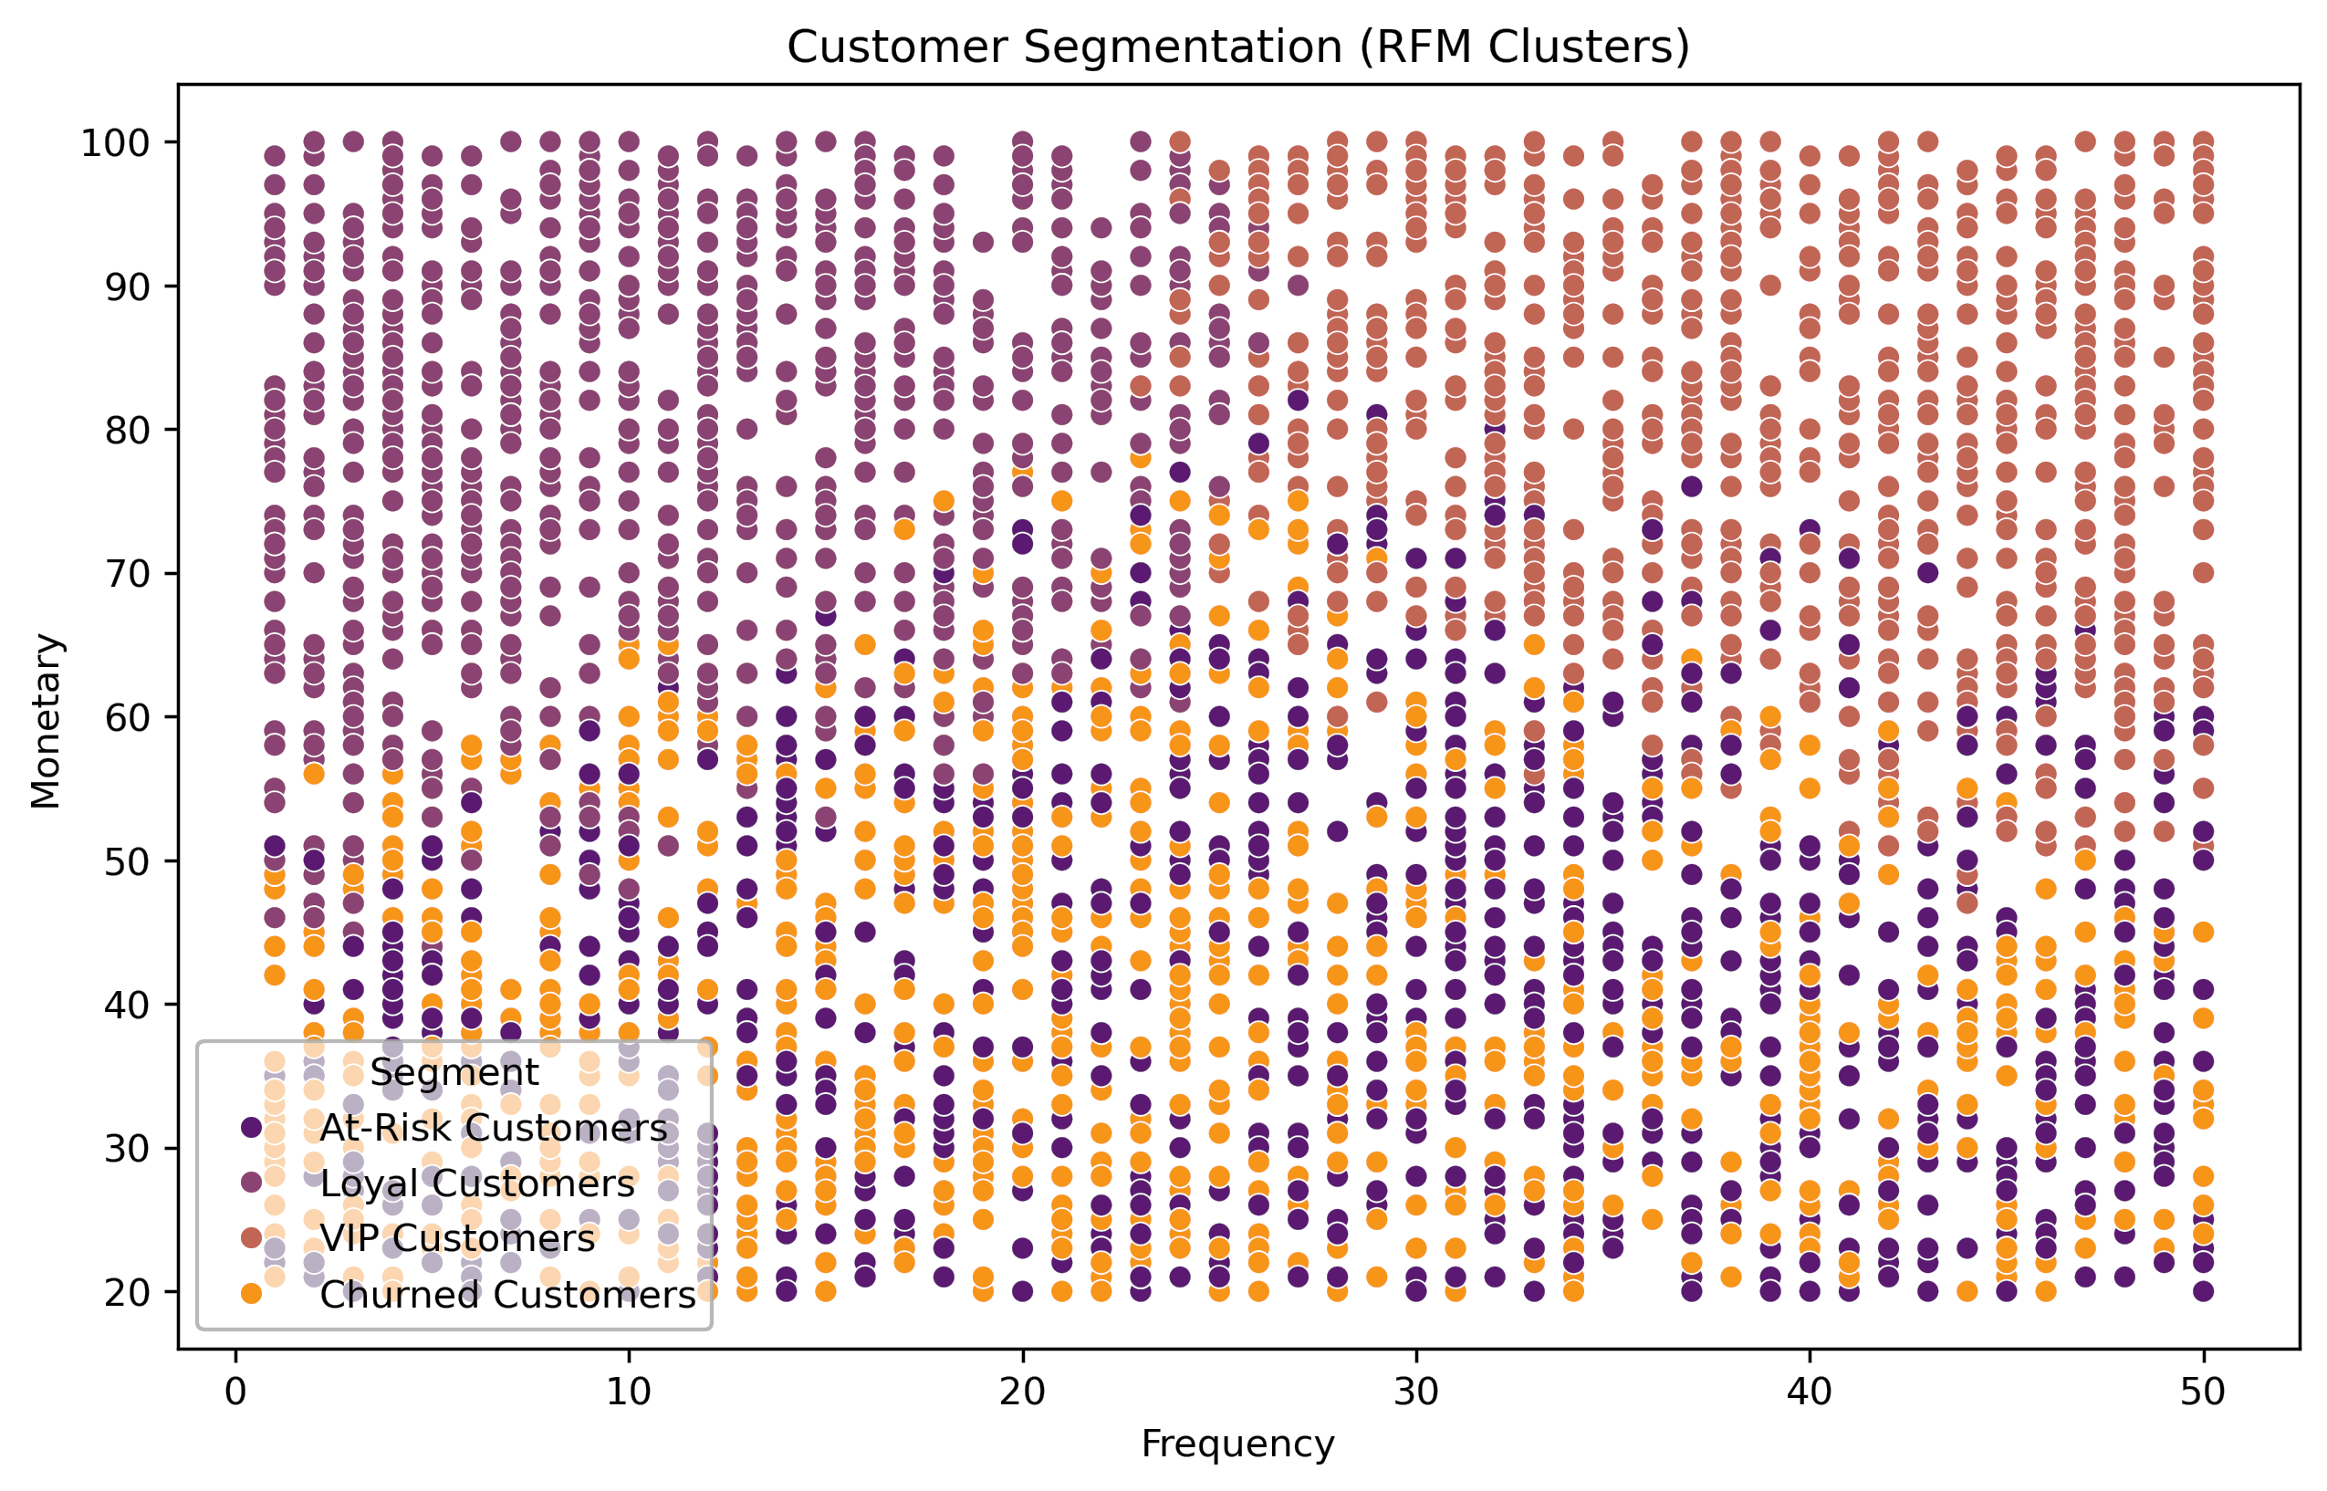
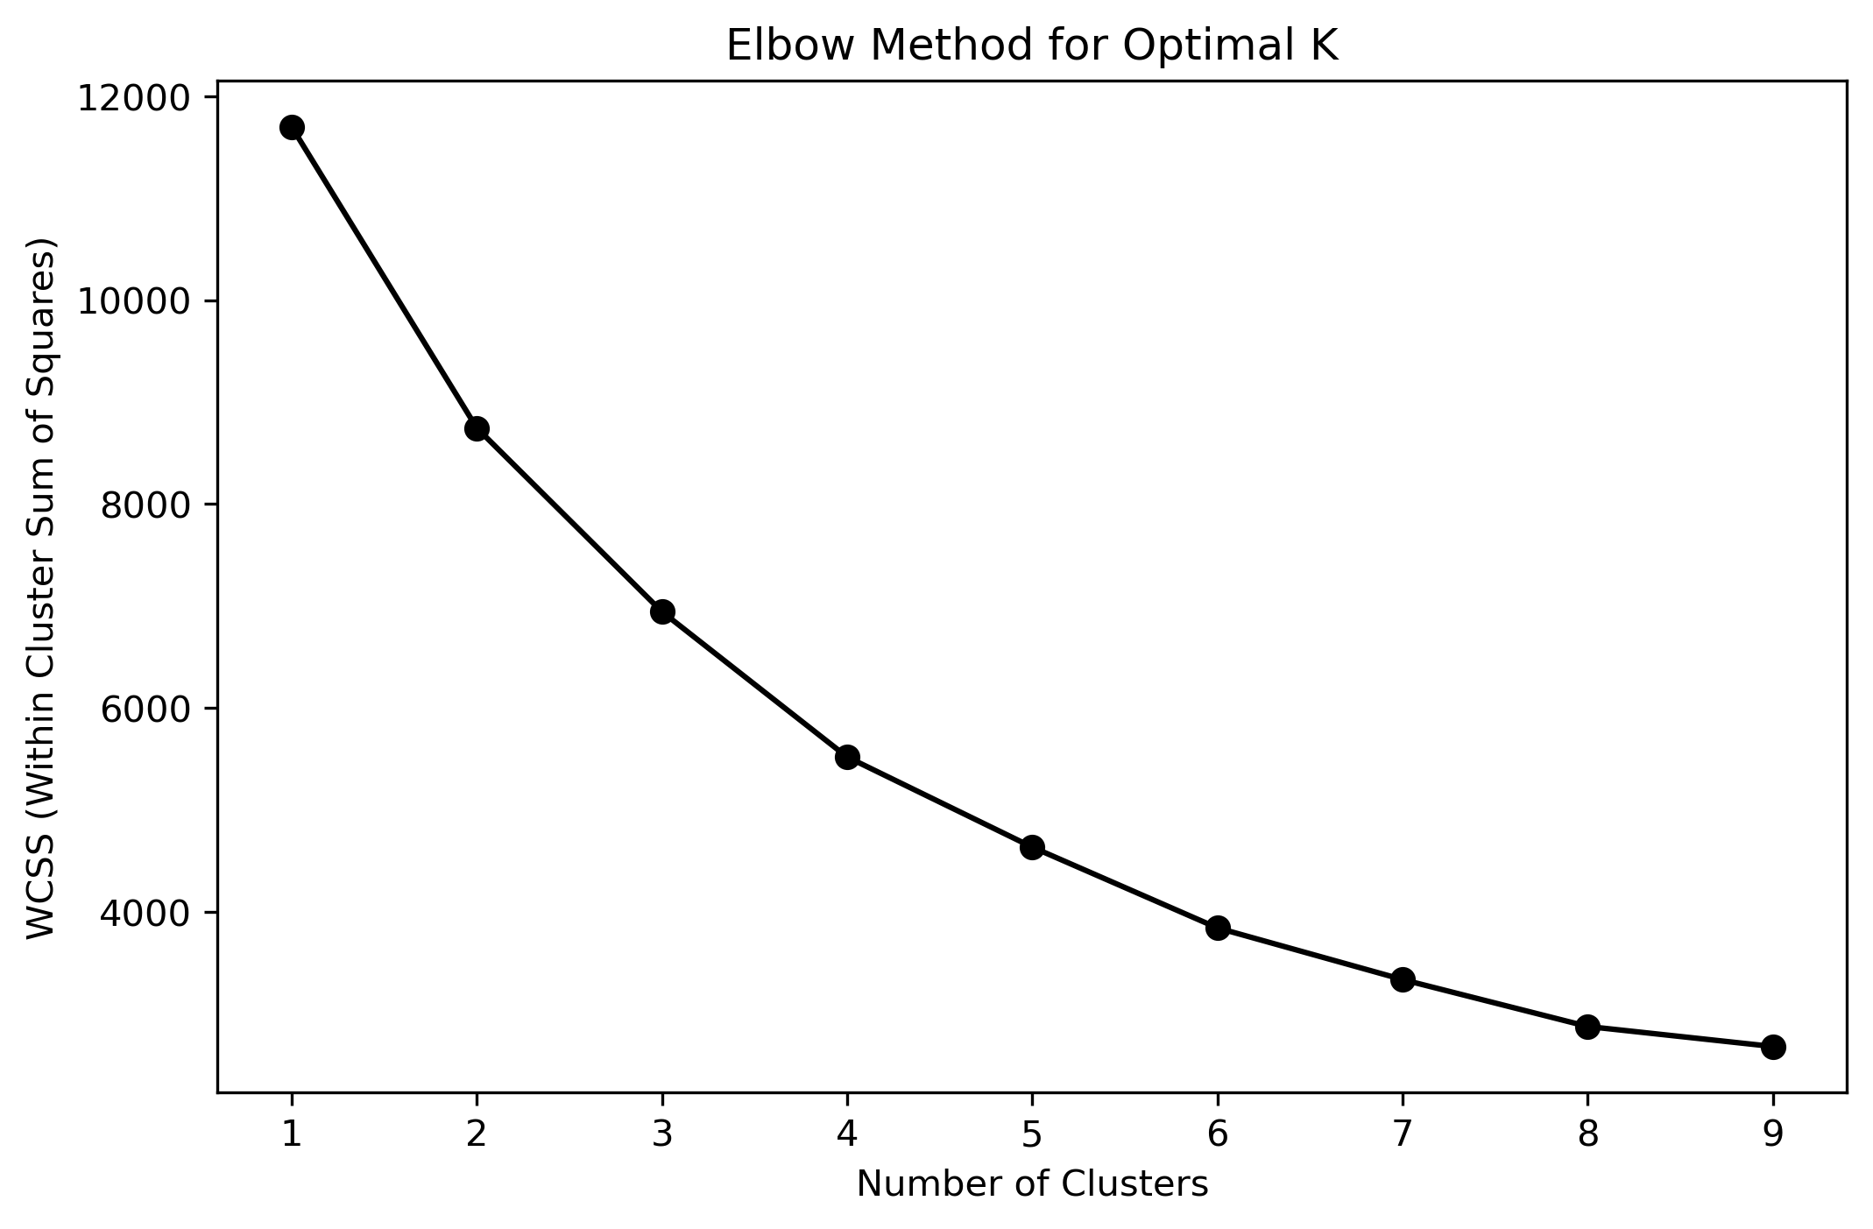
b. Multivariate Visualizations
Customer Segmentation & Targeting
Based on the graph, the elbow appears around K=3 or K=4, meaning that segmenting the data into 3 or 4 clusters would likely be most effective.
VIP customers are positioned in the upper-right, indicating high spending and frequent purchases.
Loyal customers are also high in monetary value but may not purchase as frequently.
At-risk customers and churned customers tend to have lower spending and less frequent purchases.
The segmentation provides valuable insights for retention strategies, such as targeting at-risk customers with promotions or personalized offers to prevent churn.

Slide 8
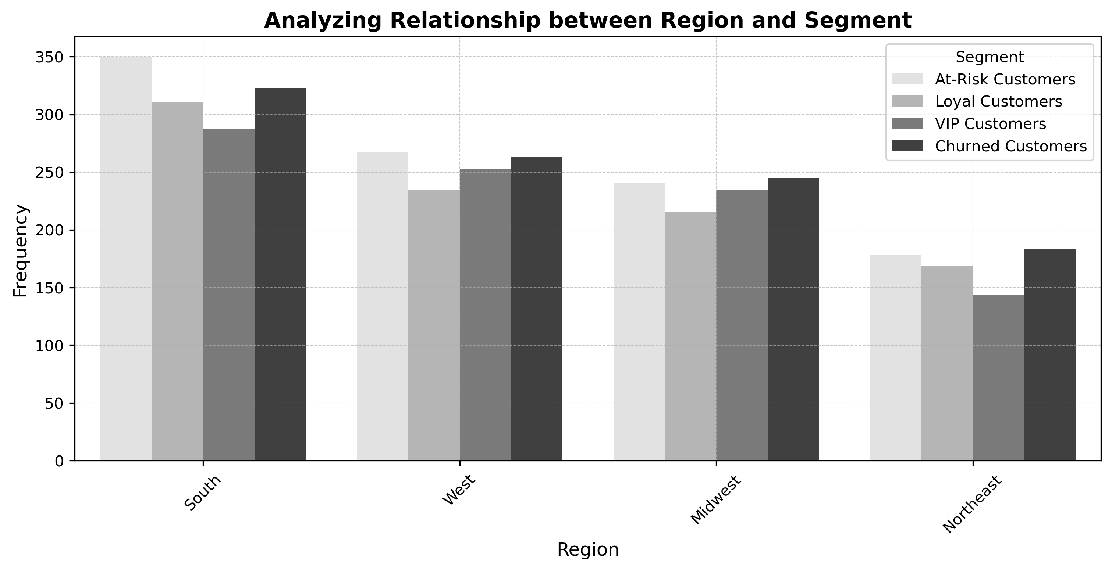
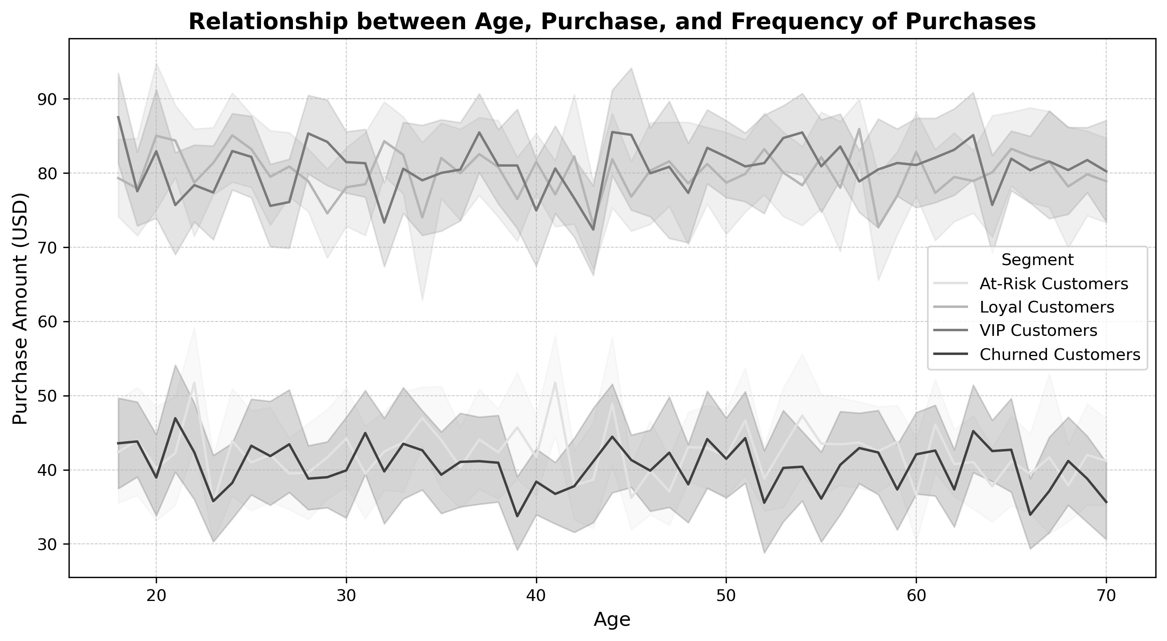
Identifying At-Risk Customer Segments: Demographic Insights on Churn
The South region has the largest customer base, followed by the West, Midwest, and Northeast. However, it also has the highest number of at-risk and churned customers, a trend that is consistent across all regions.
To improve customer retention, targeted engagement strategies should be implemented in the South region, focusing on personalized offers, loyalty programs, and proactive customer support. Additionally, analyzing churn patterns in other regions can help tailor region-specific retention initiatives.
VIP and Loyal Customers: These customers have higher purchase amounts (80–90 USD) across all ages. Their purchase behavior appears relatively stable, with some fluctuations. At-Risk and Churned Customers: These customers spend significantly less (40–50 USD).Their spending pattern fluctuates but remains consistently lower than VIPs and Loyal customers.
To improve customer retention, TrendStyle should engage at-risk and churned customers with personalized offers or discounts to boost retention.

Slide 9
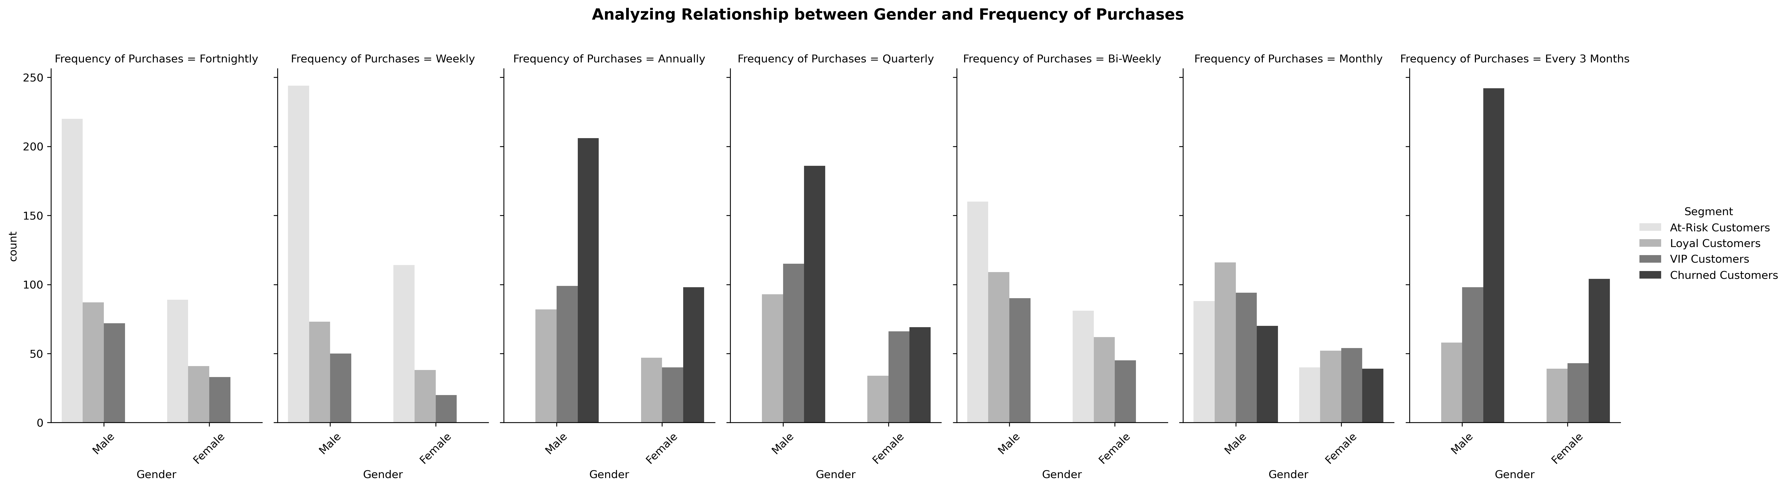
Demographic Insights on Churn
Male customers dominate in certain purchase frequency categories. In the fortnightly, bi-weekly, and weekly frequency categories, both male and female customers exhibit a similar trend, with over 200 at-risk customers in each. However, in the quarterly category, churned male customers are the highest. Additionally, the "every 3 months" and "annually" categories have the largest number of churned customers overall
To improve retention, targeted engagement strategies should be implemented for quarterly, 3-month, and annual shoppers, especially male customers. Personalized promotions, loyalty rewards, or subscription-based incentives could encourage more frequent purchases and reduce churn.

Slide 10
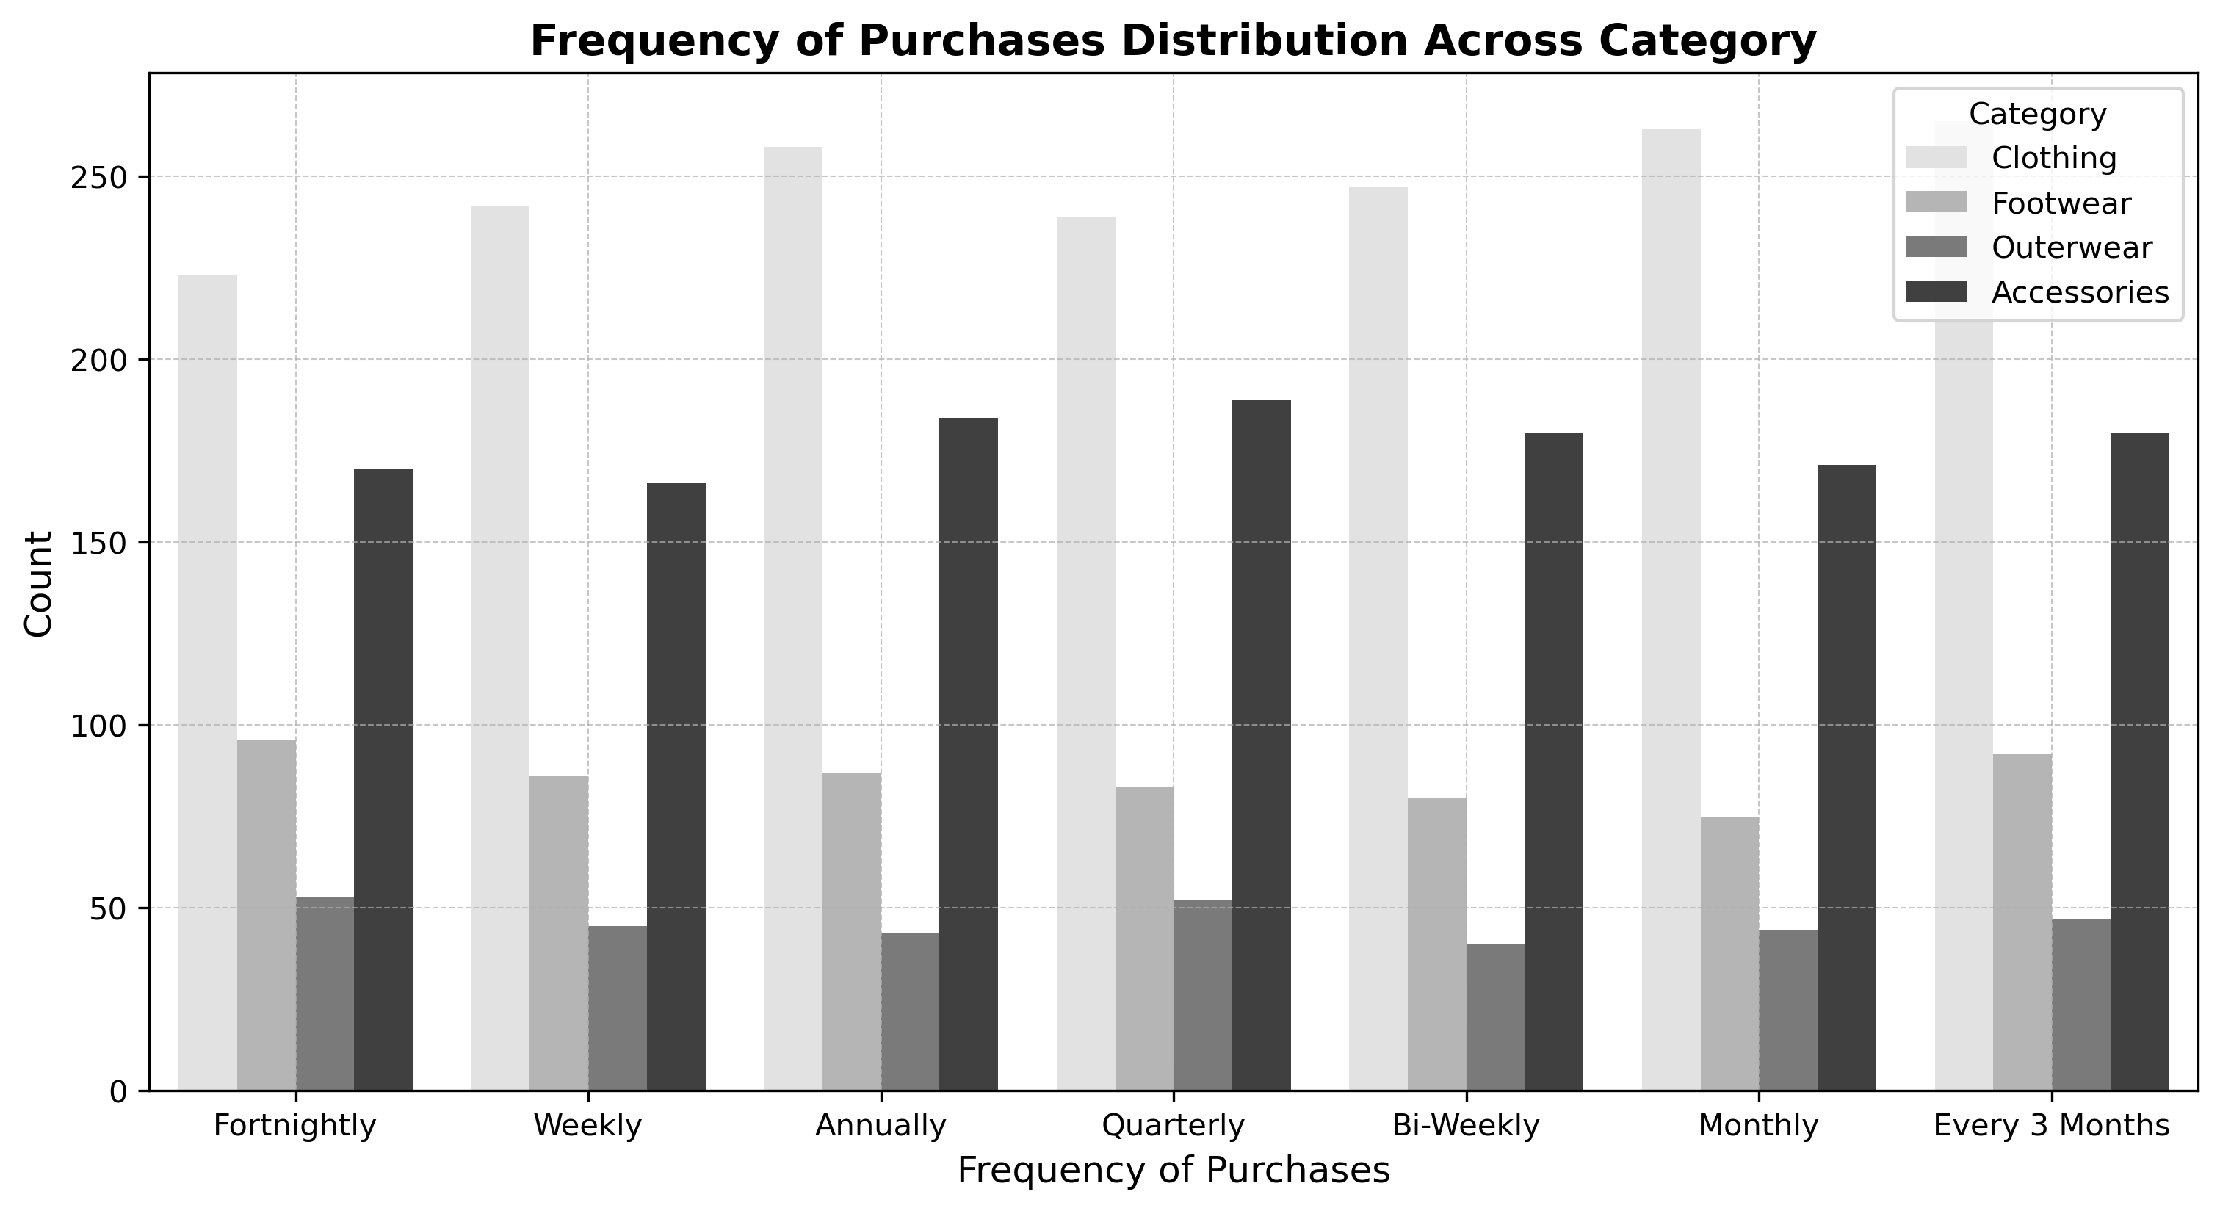
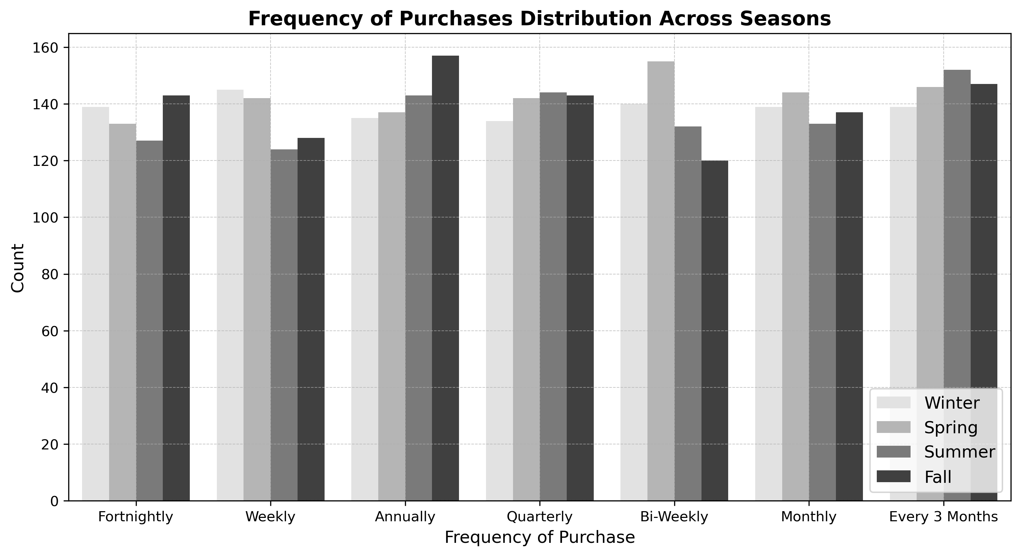
Purchasing Behavior & Trends
Clothing is the most frequently purchased category, with over 200 purchases, followed closely by accessories, which exceed 150. In contrast, footwear and outerwear are the least popular, with fewer than 100 purchases. Outerwear, in particular, has the lowest purchase volume, nearing just 50. To boost sales in the less popular categories, TrendStyle could consider targeted promotions, bundling offers, or seasonal discounts on footwear and outerwear to encourage more customer engagement.
During Spring, the most common purchase frequencies are bi-weekly and monthly. In Fall, customers primarily make purchases annually and fortnightly. Quarterly purchases remain consistent across all seasons. In Summer, the most frequent purchase pattern is every three months, while in Winter, purchases are most commonly made weekly. Given these seasonal trends, targeted promotions and personalized marketing strategies should align with customer purchasing behaviors.

Slide 11
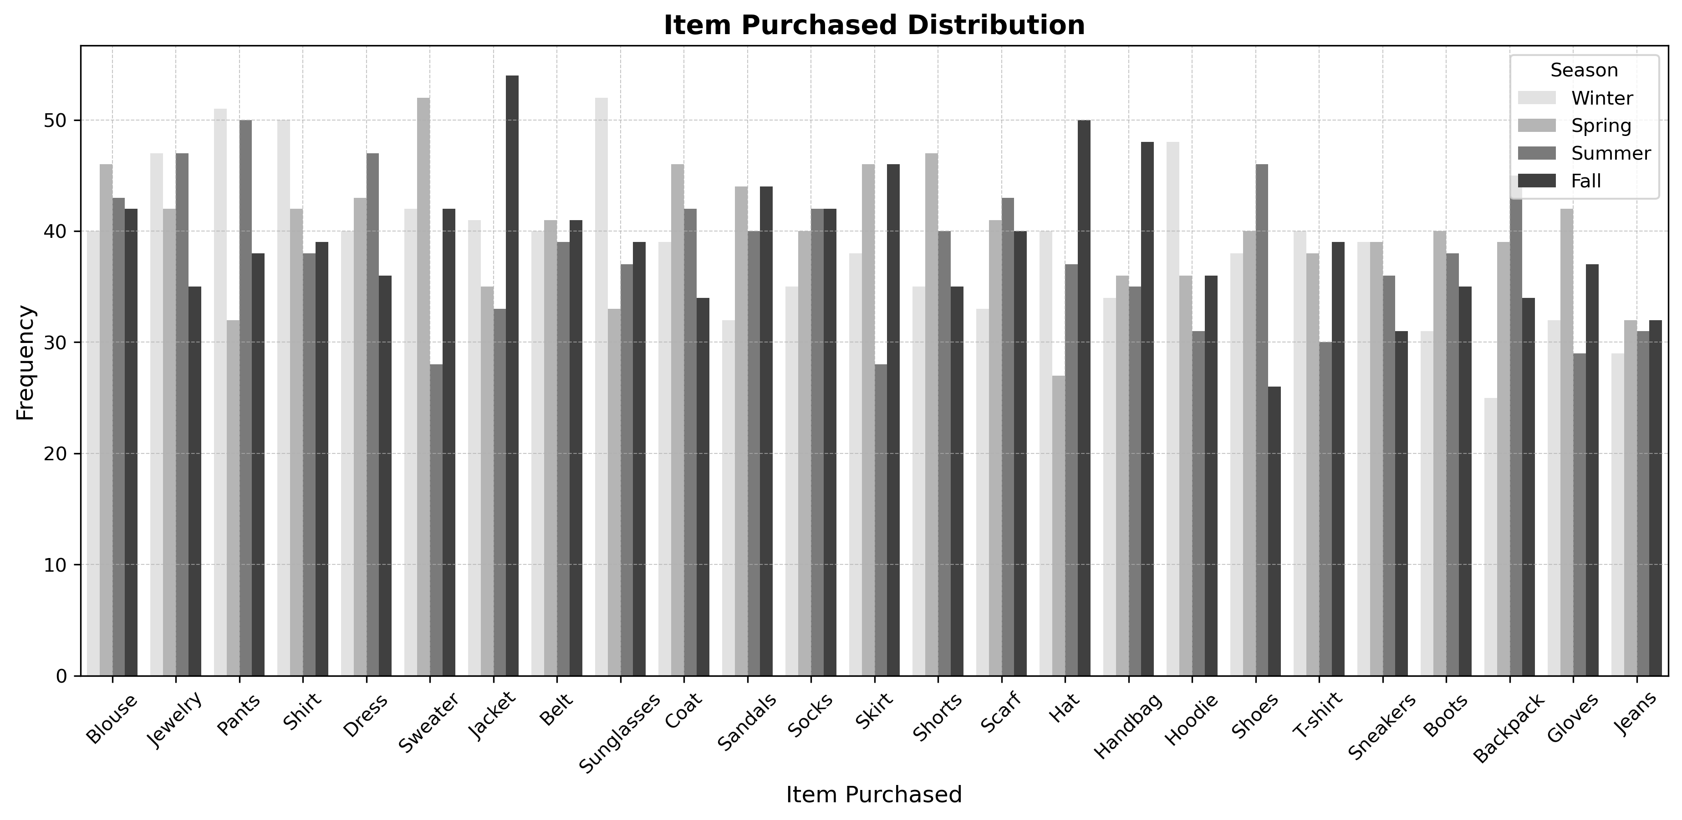
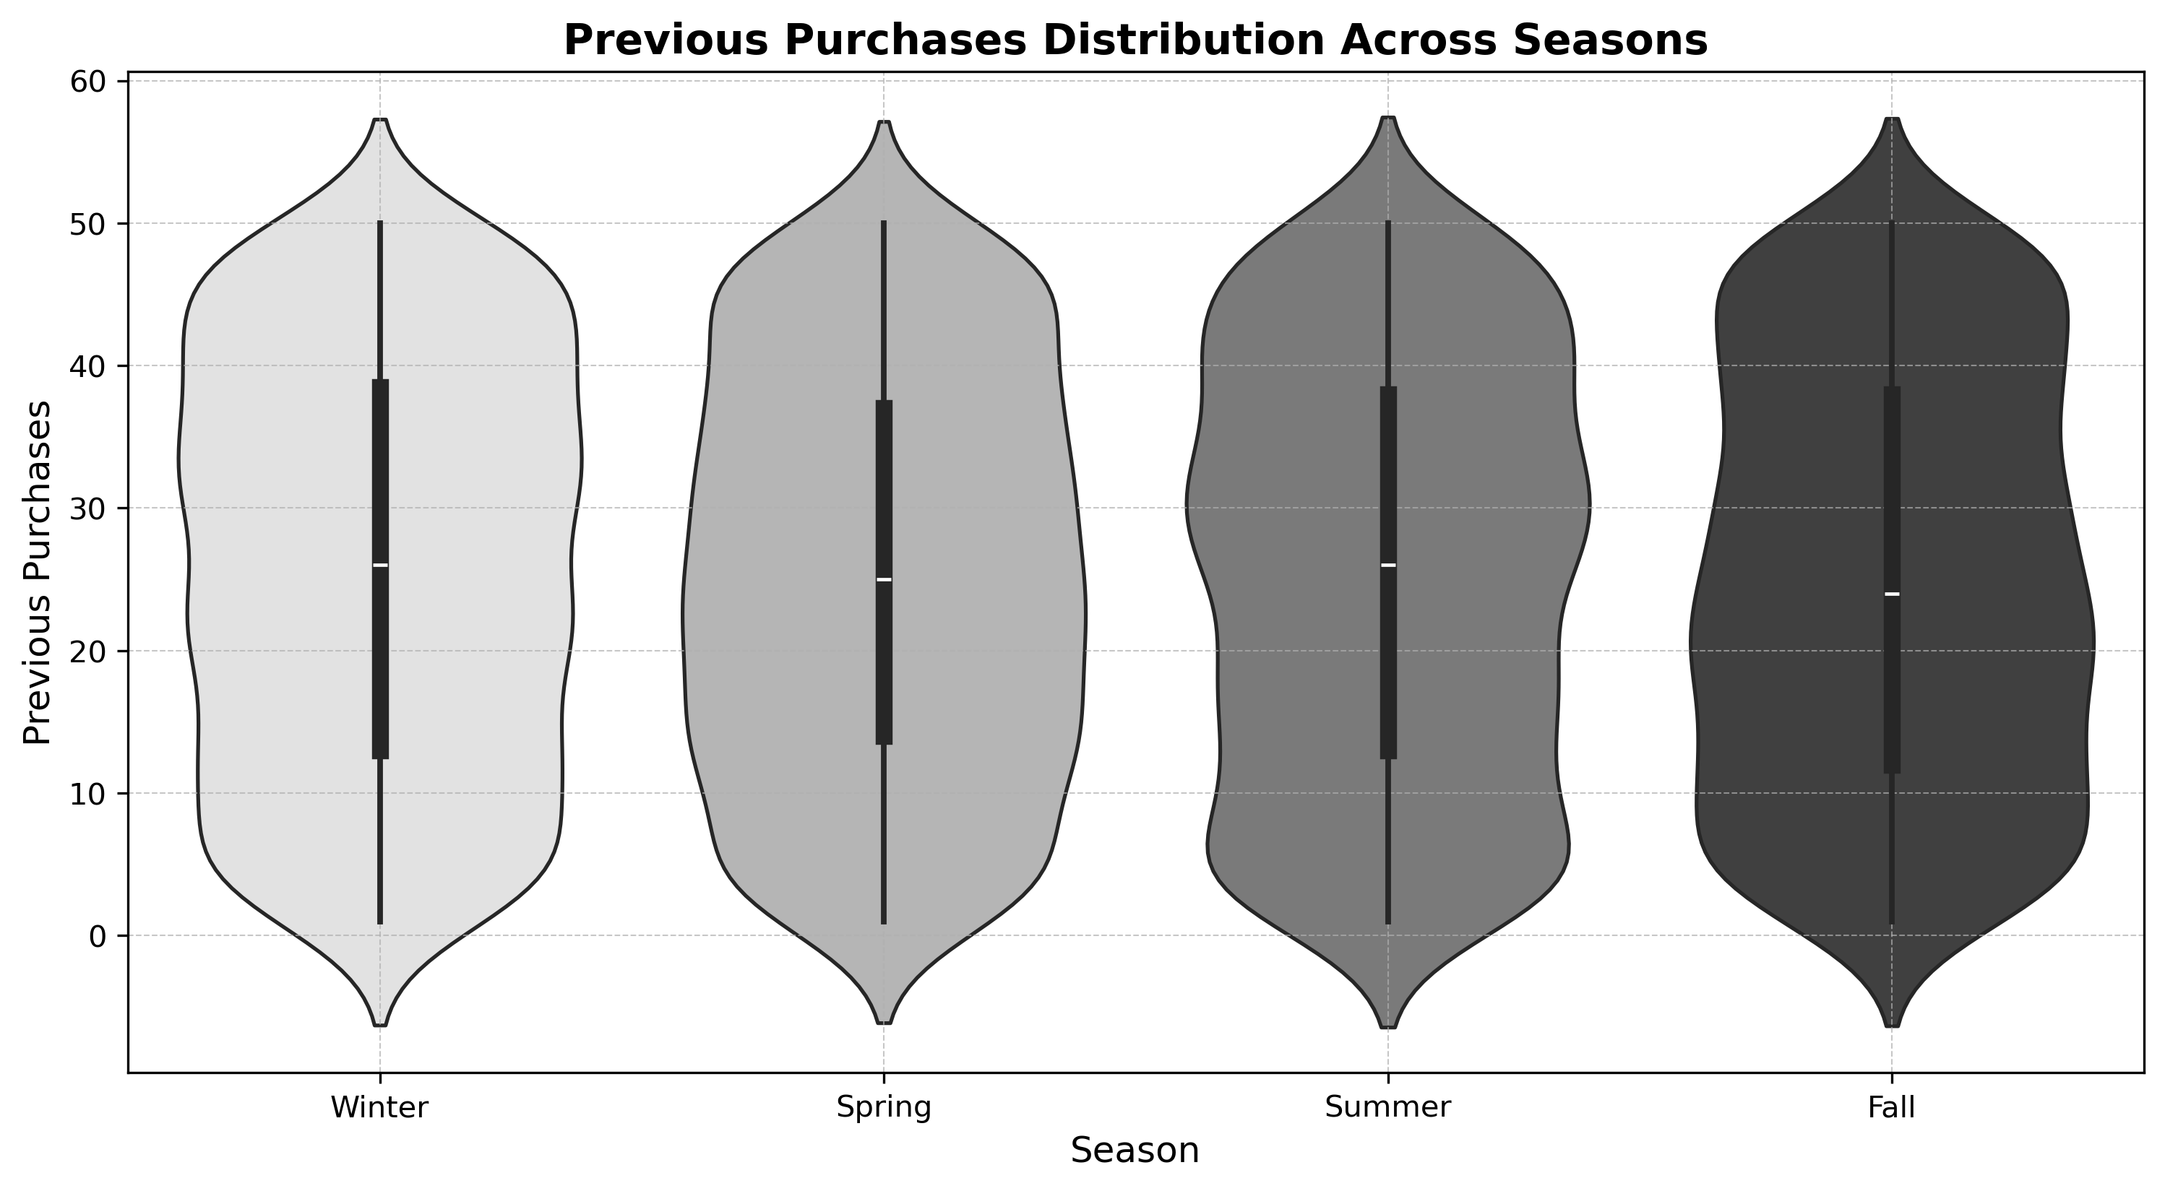
Purchasing Behavior & Trends
Jackets, handbags, and hats are the most purchased items during the fall season, while jeans are the least bought item across all seasons. In spring, the most popular items include sneakers, shorts, blouses, and gloves. During winter, hoodies, shirts, and sunglasses see the highest demand. In summer, dresses, backpacks, and sweaters are the top-selling items. TrendStyle could optimize inventory and marketing strategies by aligning promotions and stock levels with seasonal preferences. For instance, increasing visibility and discounts on jeans may help improve their sales, while ensuring sufficient stock of seasonal favorites can maximize revenue.
Based on the violin plot, the distribution of previous purchases appears fairly consistent across the different seasons. Each violin has a similar shape, indicating that the frequency of past purchases does not vary significantly between seasons. The median values are also consistent, meaning that there are no drastic seasonal differences. The violins have slight variations in width suugesting that a small subset of customers may engage in more frequent purchases during specific periods.

Slide 12
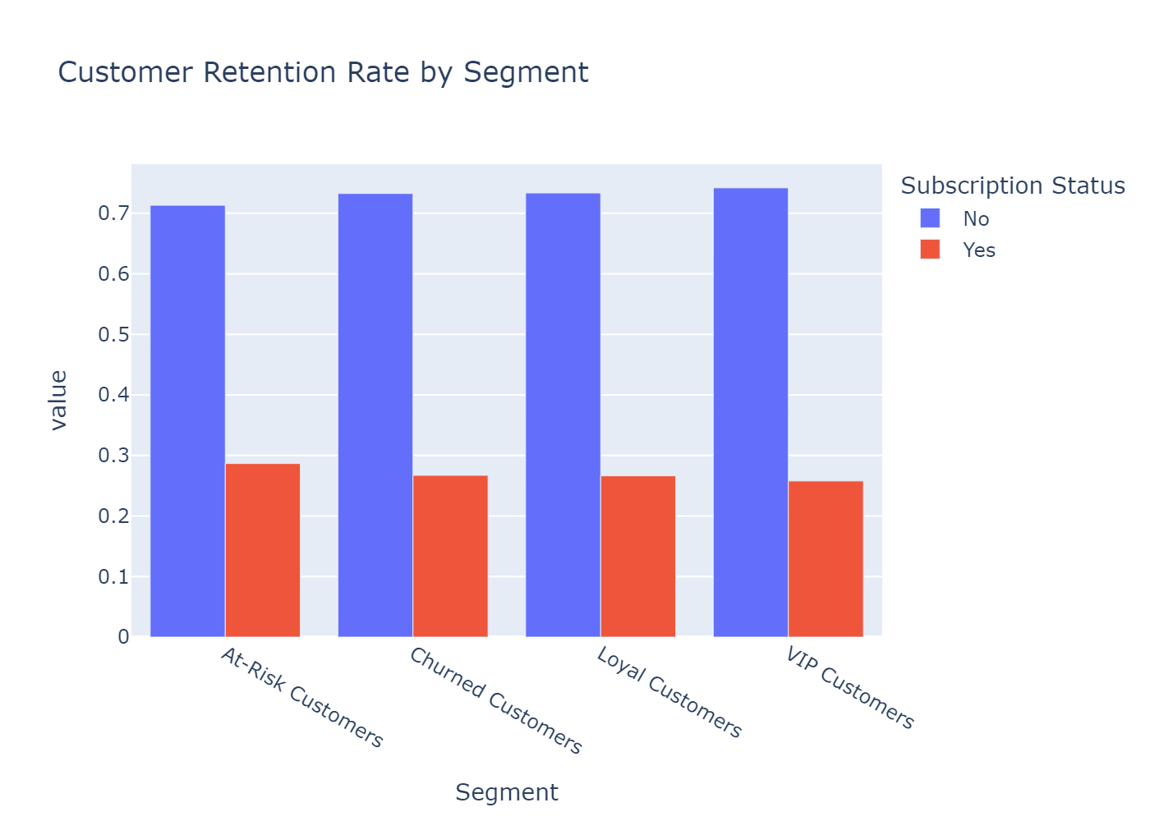
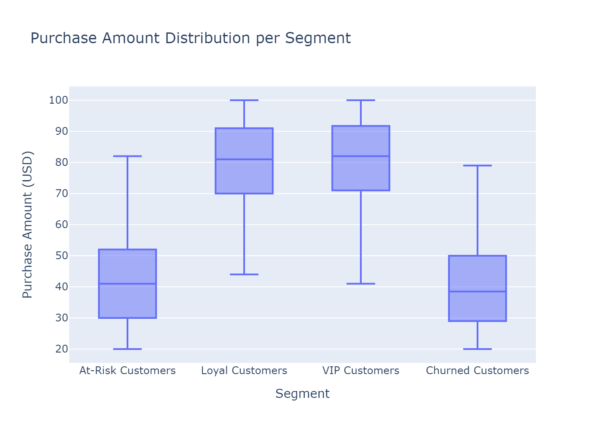
Customer Retention and Purchase Behavior Analysis
1. Customer Retention Rate by Segment
The first visualization analyzes customer retention rates across different segments.
It calculates the proportion of Active vs. Canceled subscriptions for each segment.
The grouped bar chart helps identify which segments have the highest retention rates and which ones are more likely to churn.
2. Purchase Amount Distribution per Segment
The second visualization examines purchase behavior by segment using a box plot.
It displays the median purchase amount, variability in spending, and potential outliers.
This helps understand which segments spend more and how their purchase amounts vary.
Recommendation:
To improve retention, focus on segments with high churn rates by offering personalized or loyalty programs. Additionally, encourage lower-spending segments to increase their purchase amounts through targeted promotions.

Slide 13
Impact Of Discount Strategies And Promo Codes On Customer Retention And Lifetime Value
Metric | Discounts | No-Discount | Promo Code | No-Promocode
CLV | $1526.02 | $1506.64 | $1526.02 | $1506.64
CRR | 62.79% | 100.00% | 62.79% | 100.00%
The data shows that customers who used promo codes or received discounts had a slightly higher lifetime value ($1526.02) compared to those who didn’t ($1506.64). However, the big concern is retention—only 62.79% of customers who used discounts or promo codes stuck around, while 100% of those who didn’t use them remained. This suggests that while discounts and promo codes might boost short-term sales, they don’t necessarily help keep customers long-term. A better approach could be to pair promotions with loyalty programs or personalized offers to keep customers coming back.

Slide 14
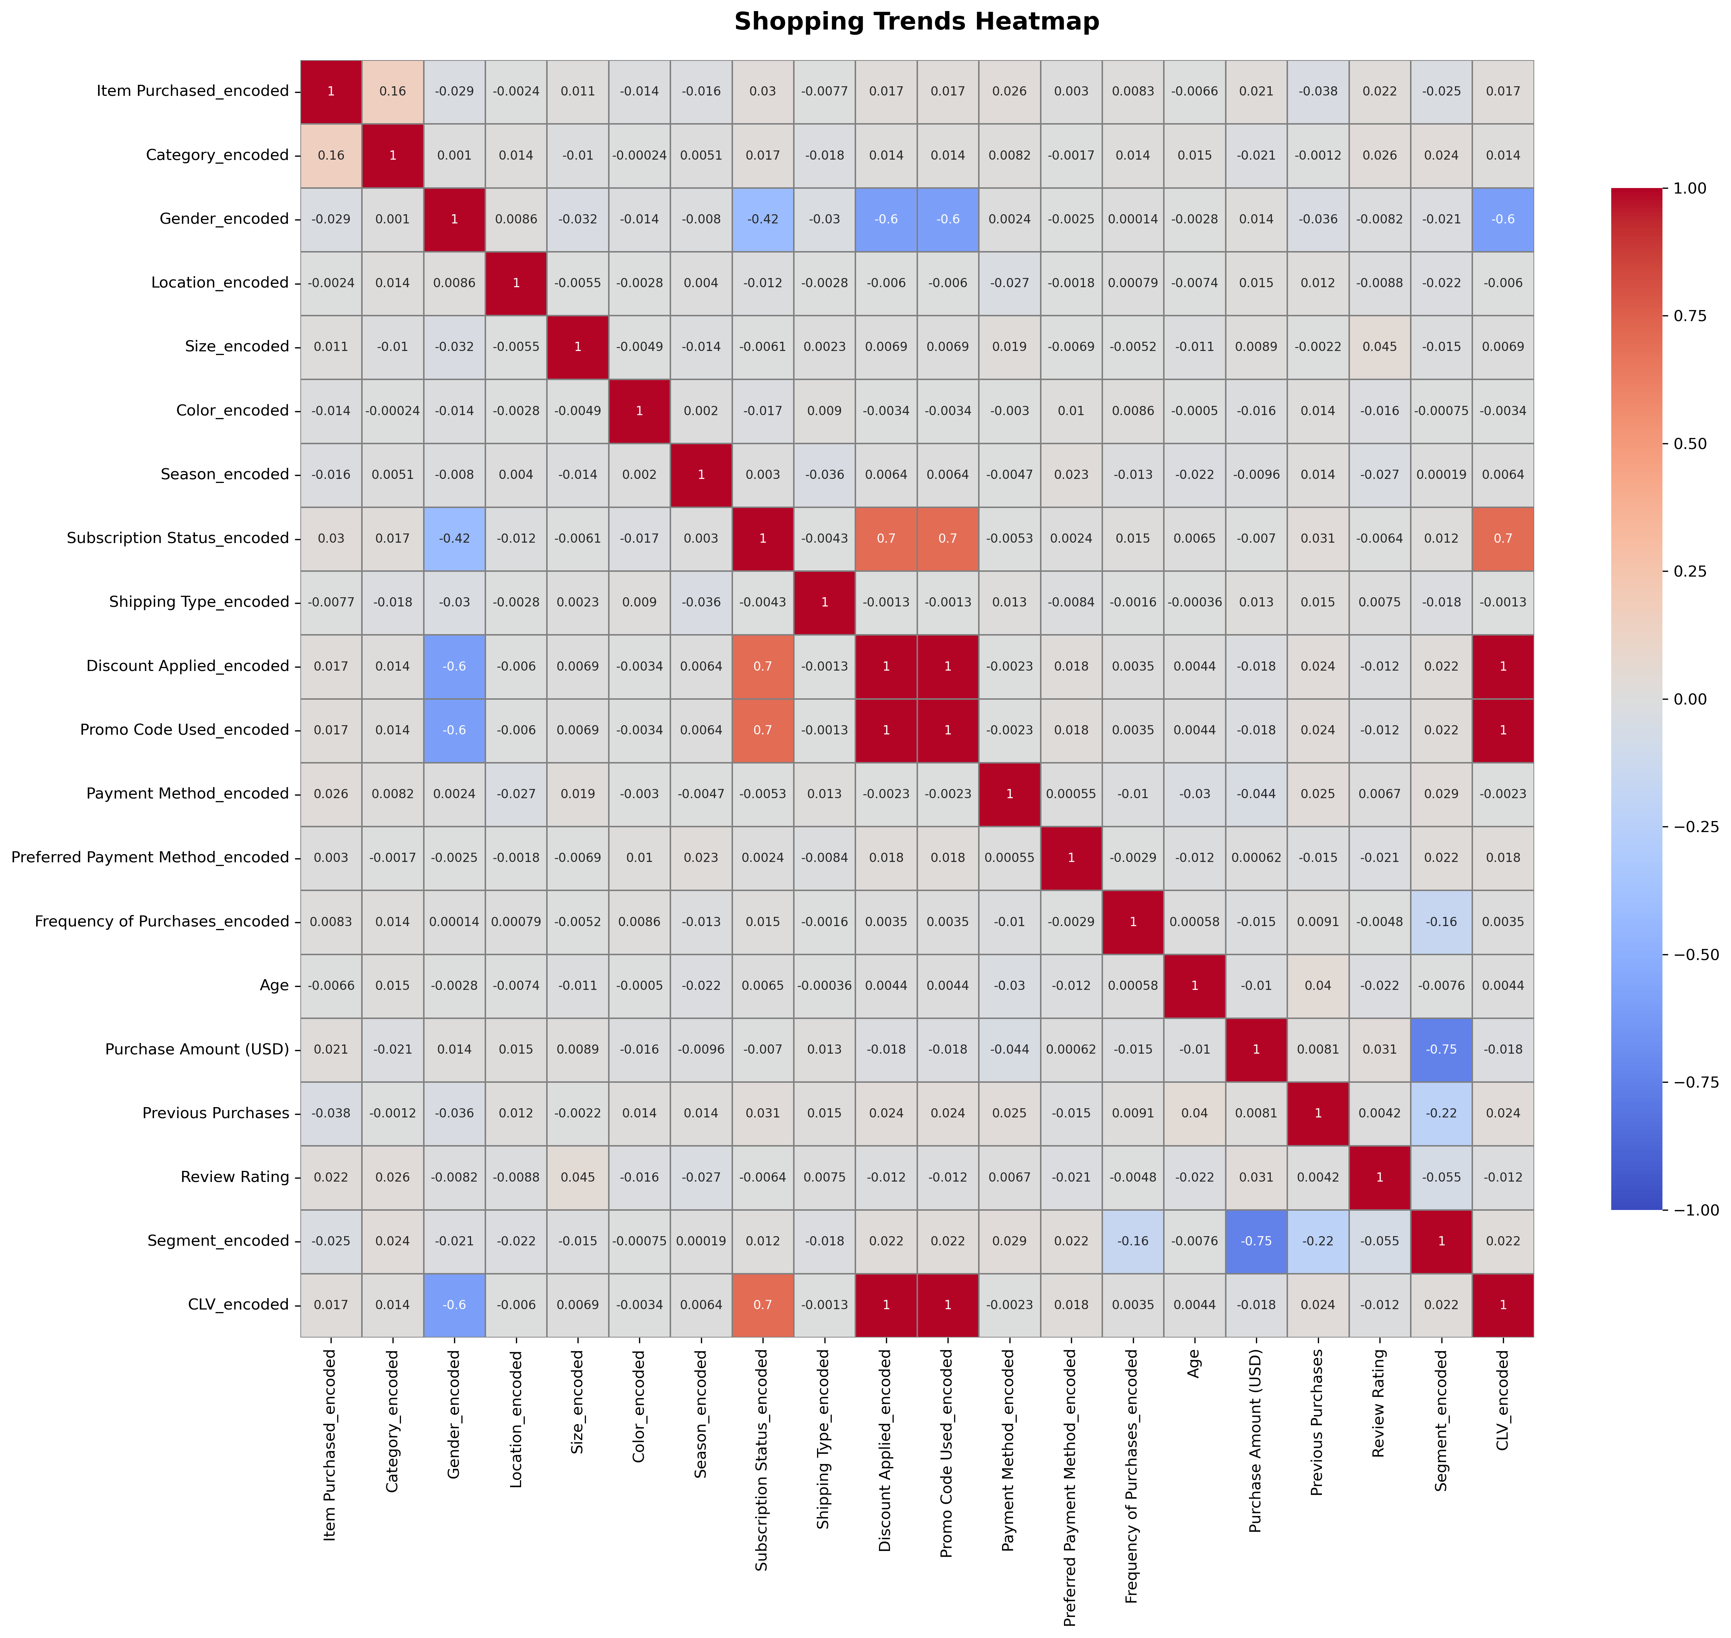
Purchase Amount has a strong negative correlation with Segment (-0.75), meaning higher spending leads to lower segment values. Frequency of Purchases (-0.16) and Previous Purchases (-0.22) have weak negative correlations with Subscription Status, while Review Rating (0.055) has little impact on segmentation.
In terms of CLV, Subscription Status has a strong positive correlation (0.7), while Gender (-0.6) shows a strong negative correlation. Discounts and Promo Codes are highly correlated with CLV, suggesting multicollinearity. Item Purchased (0.017), Preferred Payment Method (0.018), Previous Purchases (0.024), and Category (0.014) have weak positive effects, while Purchase Amount (-0.018) and Review Rating (-0.012) have slight negative effects.

Slide 15
Steps to Build the Customer Churn Model
Preprocessing
1. Identify the target variable and features:
Target- Segment encoded
Features-Purchase Amount (USD),Previous Purchases ,Frequency of Purchases encoded and Review Rating. The other columns showed weak correlations with segment encoded based on the heatmap and visualizations. Therefore, these features were excluded from the analysis.
2. Standardized numerical features using Standard Scaler.
3. Split the data into training and testing sets using the 80-20 ratio.
Models Used
1. Gradient Boosting Model
2. Decision Tree Model
3. Random Forest Model
MODEL
SELECTION

Slide 16
Model Performance Comparison
Random Forest Model
Accuracy Score: 0.985
Classification Report:
 | precision | recall | f1-score | support
0 | 0.95 | 0.99 | 0.97 | 167
1 | 0.98 | 0.98 | 0.98 | 171
2 | 1.00 | 0.97 | 0.98 | 214
3 | 0.99 | 0.98 | 0.98 | 228
CONFUSION MATRIX | [[165 1 1 0] [ 0 168 0 3] [ 4 2 208 0] [ 5 0 0 223]]
Gradient Regression Model
Accuracy Score: 0.985
Classification Report:
 | precision | recall | f1-score | support
0 | 0.98 | 0.99 | 0.98 | 167
1 | 0.98 | 0.98 | 0.98 | 171
2 | 1.00 | 0.98 | 0.99 | 214
3 | 0.99 | 1.00 | 0.99 | 228
CONFUSION MATRIX | [[165 2 0 0] [ 1 167 0 3] [ 2 2 210 0] [ 1 0 0 227]]
The model achieves an accuracy of 98%, indicating a strong fit. Precision is 95% for VIP Customers, 98% for Loyal Customers, 100% for At-Risk Customers, and 99% for Churned Customers. Recall remains high across all classes, ranging from 97% to 99%. F1-scores indicate strong performance across all categories (0.97–0.98). The confusion matrix shows minimal misclassifications, with Class 2 (At-Risk Customers) having the highest precision, and Class 3 (Churned Customers) showing some minor misclassification with Class 0 (VIP Customers).
The model demonstrates high accuracy (99%), indicating a strong fit. Precision is 98% for VIP Customers, 98% for Loyal Customers, 100% for At-Risk Customers, and 99% for Churned Customers. Recall remains high across all classes, ranging from 98% to 100%. F1-scores indicate strong performance across all categories (0.98–0.99). The confusion matrix shows minimal misclassifications, with the largest misclassification occurring in Class 1 (Loyal Customers), where a few were predicted as Class 3 (Churned Customers.)
Final Model
Gradient Boost Model. This is because of its high performance since it has the best accuracy and high F1 scores compared to the Random Forest Model.

Slide 17
Steps to Build the Customer Lifetime Prediction Model
Preprocessing
1. Identify the target variable and features:
Target- CLV encoded
Gender encoded, Item Purchased encoded , Category encoded , Segment encoded, Subscription Status encoded , Preferred Payment Method encoded , Purchase Amount (USD) ,'Previous Purchases , Review Rating . The other columns showed weak correlations with CLV encoded based on the heatmap and visualizations. Therefore, these features were excluded from the analysis.
2. Standardized numerical features using Standard Scaler.
3. Split the data into training and testing sets using the 80-20 ratio.
Models Used
1. Logistic Regression
2. Gradient Boosting Model
3. XGBoost Model
MODEL
SELECTION

Slide 18
Model Performance Comparison
Logistic Regression Model
Accuracy Score: 0.83
Classification Report:
 | precision | recall | f1-score | support
0 | 0.76 | 1.00 | 0.86 | 422
1 | 1.00 | 0.62 | 0.77 | 358
CONFUSION MATRIX | [[422 0] [136 222]]
Gradient Boost Model
Accuracy Score: 0.80
Classification Report:
 | precision | recall | f1-score | support
0 | 0.76 | 0.94 | 0.84 | 422
1 | 0.90 | 0.65 | 0.75 | 358
CONFUSION MATRIX | [[395 27] [125 233]]
The model achieves an 83% accuracy, indicating a good fit. . Class 0 (CLV = 1506) has 76% precision and 100% recall, while Class 1 (CLV = 1526) has 100% precision but lower 62% recall. The F1-scores are 0.86 for Class 0 (good performance) and 0.77 for Class 1 (moderate performance). The confusion matrix shows 422 correctly classified cases for Class 0 and 222 correct predictions for Class 1, with 136 misclassified as Class 0 .
Final Model
Logistic Regression Model. This is because of its high performance since it has the best accuracy and high F1 scores compared to the Gradient Boost Model .
The model achieves an 80% accuracy, indicating a good fit. Class 0 (CLV = 1506) has 76% precision and 94% recall, while Class 1 (CLV = 1526) has 90% precision but lower 65% recall. The F1-scores are 0.84 for Class 0 (good performance) and 0.75 for Class 1 (moderate performance). The confusion matrix shows 395 correctly classified cases for Class 0, with 27 misclassified as Class 1, and 233 correct predictions for Class 1, with 125 misclassified as Class 0. Overall, the model performs well but could be improved in distinguishing Class 1 cases.

Slide 19
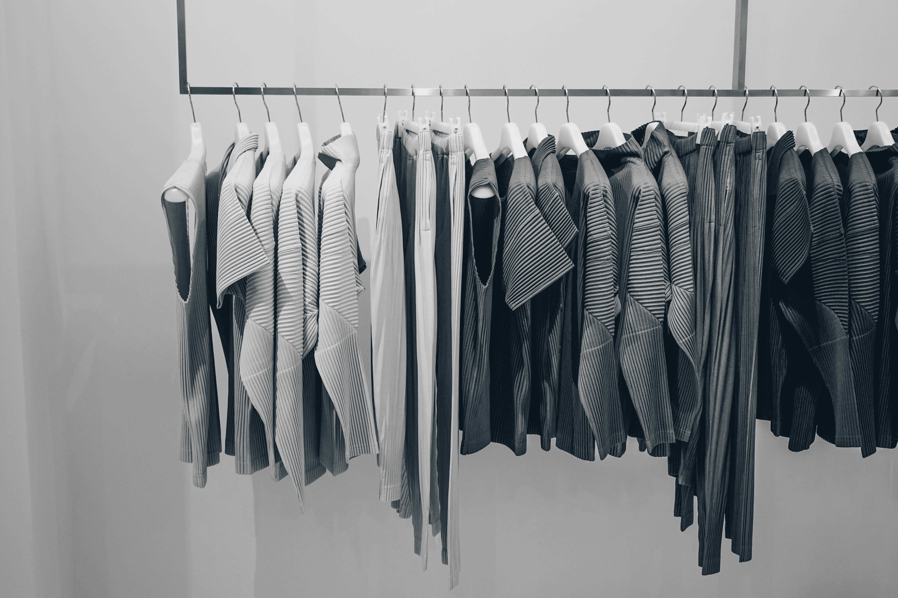
RECOMMENDATIONS
1. Reward At-Risk Customers
By offering special discounts or early access to new collections and creating a loyalty program with exclusive rewards. Customers who haven't shopped in a while may need an extra push to return. Providing personalized discounts or early access to new collections can rekindle their interest.
2. Improve Subscription Perks
Adding benefits like free shipping, exclusive discounts, or VIP support. Customers are more likely to maintain their subscriptions if they see added value. Offering perks such as free shipping, members-only discounts, or priority customer support can enhance the subscription experience and encourage long-term commitment.
3. Win Back Lost Customer
By using limited-time discounts to create urgency. Customers who have stopped shopping might return with the right incentive. Sending personalized re-engagement emails featuring tailored offers can reignite their interest. Limited-time discounts can also create urgency and encourage them to make a purchase.
4. Make Payments Easier
Offer flexible payment options like Buy Now, Pay Later. A seamless checkout experience can reduce cart abandonment. Flexible payment options such as Buy Now, Pay Later and digital wallets provide convenience and affordability. Small incentives, like extra reward points for using a preferred payment method, can further encourage purchases.
5. Suggest the Right Products
Recommend products based on past purchases and shopping trends. Show personalized suggestions on the website and emails.

Slide 20
Stream lit App Deployment
Interactive Web Application
Predicting Customer Churn and Customer Lifetime Value
This website is designed to predict Customer Lifetime Value (CLV) and Customer Churn using machine learning. By analyzing customer behavior, purchasing patterns, and engagement metrics, it provides actionable insights to help businesses improve retention, optimize marketing strategies, and maximize revenue.
To determine customer segmentation, users need to provide details such as purchase amount (USD), previous purchases, frequency of purchases (encoded), and review rating. For predicting CLV, the required inputs include gender (encoded), item purchased (encoded), category (encoded), segment (encoded), subscription status (encoded), preferred payment method (encoded), purchase amount (USD), previous purchases, and review rating. By analyzing these features, this platform helps businesses enhance customer retention, optimize marketing strategies, and drive revenue growth.
Here is the stream lit link to the website: https://shopping-trend-analysis-eeqylzejkuivdivhruvusb.streamlit.app/

